Slide 1
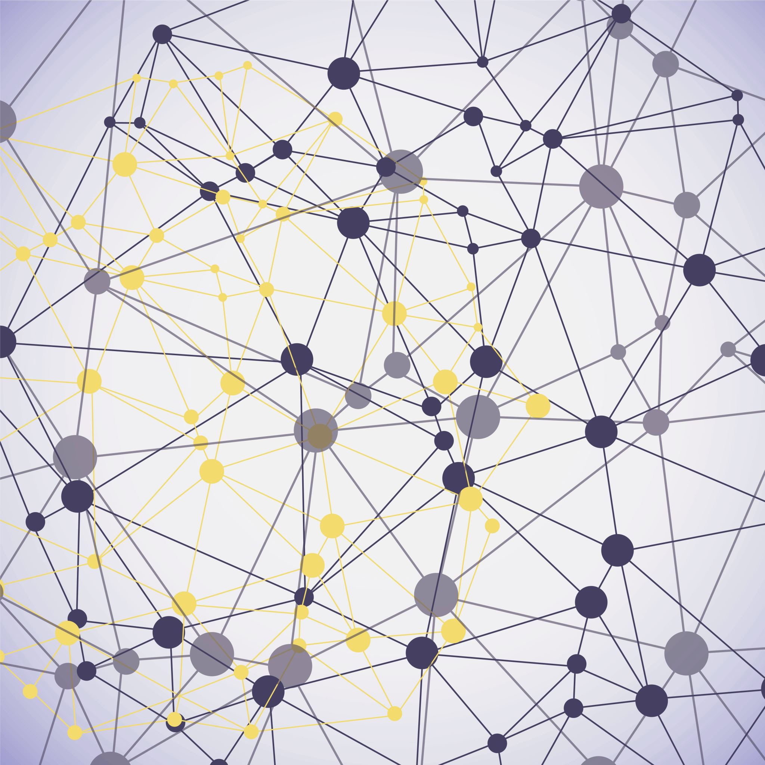
Variants of Graph Coloring

Slide 2
ID: 1905098
Name: Rakib Kibria

Slide 3
Graph Coloring
Definition: A graph is said to have k-coloring if it uses at most k-colors to color all the vertices of that graph such that no two adjacent vertices share the same color.
3-coloring of a graph

Slide 4
For k>=3 Graph coloring problem is NP COmplete

Slide 5
Variations
Acyclic Coloring
List Coloring
Distance Coloring
Total Coloring

Slide 6
Acyclic Coloring
Definition: A graph G is said to have acyclic p-coloring if we can color the graph using p colors such that no two adjacent vertexes get the same color and there is no 2 colored cycle in the graph
Not acyclic colored
acyclic 3-colored

Slide 7
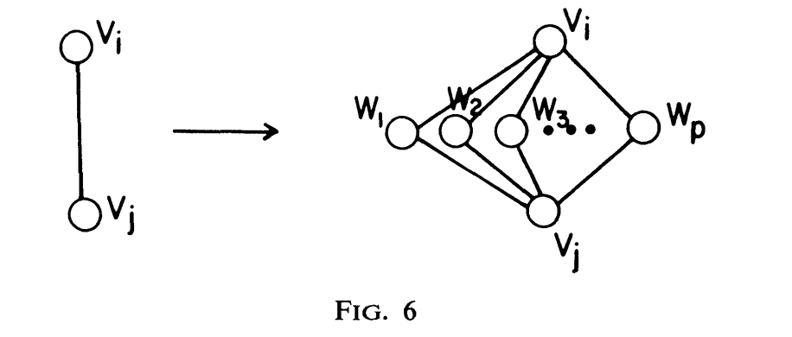
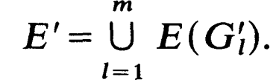
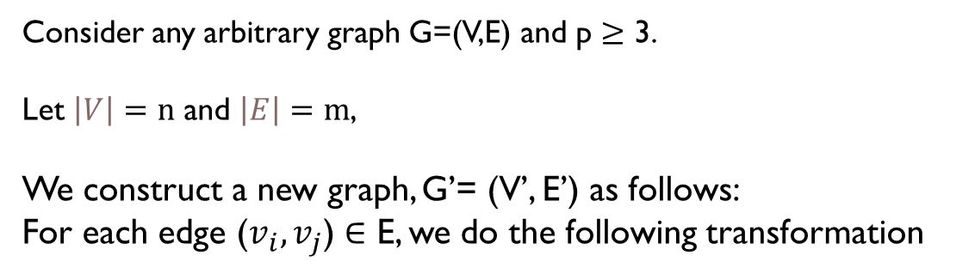
p-coloring problem is polynomially reducable
to Acyclic p-coloring problem
Proof:
Consider any arbitrary graph G=(V,E) and p $≥$ 3.
Let $\left|V\right|=n$ and $\left|E\right|=m$,
We construct a new graph, G’= (V’, E’) as follows:
For each edge ($v_{i},v_{j}$) $∈$ E, we do the following transformation

Slide 8
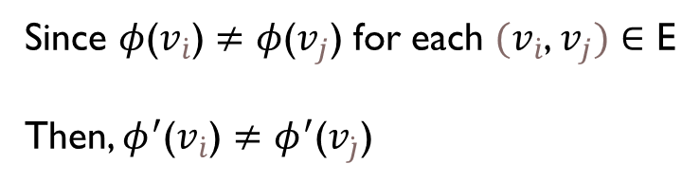

Now, we claim that if G is p-colorable if and only if G’ is acyclic p-colorable
Necessity Condition:
If G is p-colorable then G’ is acyclic p-colorable
Let G can be p-colored using an assignment$φ$ and G’ can be colored using an assignment $φ^{′}$. Now, we have to show that $φ^{′}$ is a acyclic p-coloring of G’
Proof:
Let $φ$(v) = $φ^{′}$(v) for each v $∈$ V
Since $φ$($v_{\dot{i}}$) $≠$ $φ$($v_{j}$) for each $(v_{\dot{i}}$, $v_{j})$ $∈$ E
Then, $φ^{′}$($v_{\dot{i}}$) $≠$ $φ^{′}$($v_{\dot{j}}$)
Now, let $φ^{′}$ assign color to the remaining vertices $w_{j}^{l}$ where $1≤j≤p$ with any color different from $φ^{′}$($v_{\dot{i}}$) and $φ^{′}$($v_{\dot{j}}$)

Slide 9
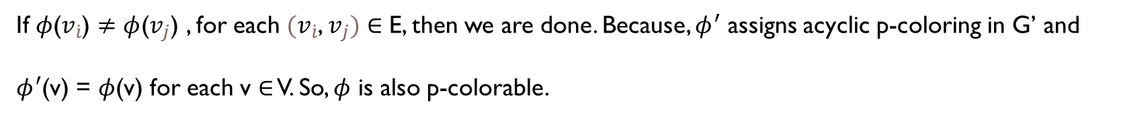
Following this construction, we can see that, any cycle in G’ will be atleast 3 coloured. Moreover, the transformation from G to G’ can be done in P time.
So, if G is p-colorable then G’ is acyclic p-colorable [Proved]
Sufficiency Condition:
if G’ is an acyclic p-colorable, then G can be also p-colorable
Assume, $φ^{′}$ be the acyclic p-coloring of G’ and $φ$ be the vertex coloring of G. Let, $φ^{′}$(v) = $φ$(v) , for each v $∈$ V Now, we claim that, $φ$ is a p-coloring of G.
If $φ$($v_{\dot{i}}$) $≠φ$($v_{j}$) , for each $(v_{\dot{i}}$, $v_{j})$ $∈$ E, then we are done. Because, $φ^{′}$ assigns acyclic p-coloring in G’ and $φ^{′}$(v) = $φ$(v) for each v $∈$ V. So, $φ$ is also p-colorable.

Slide 10
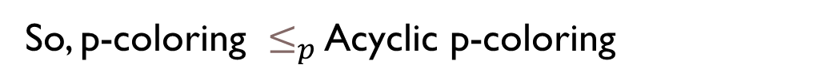
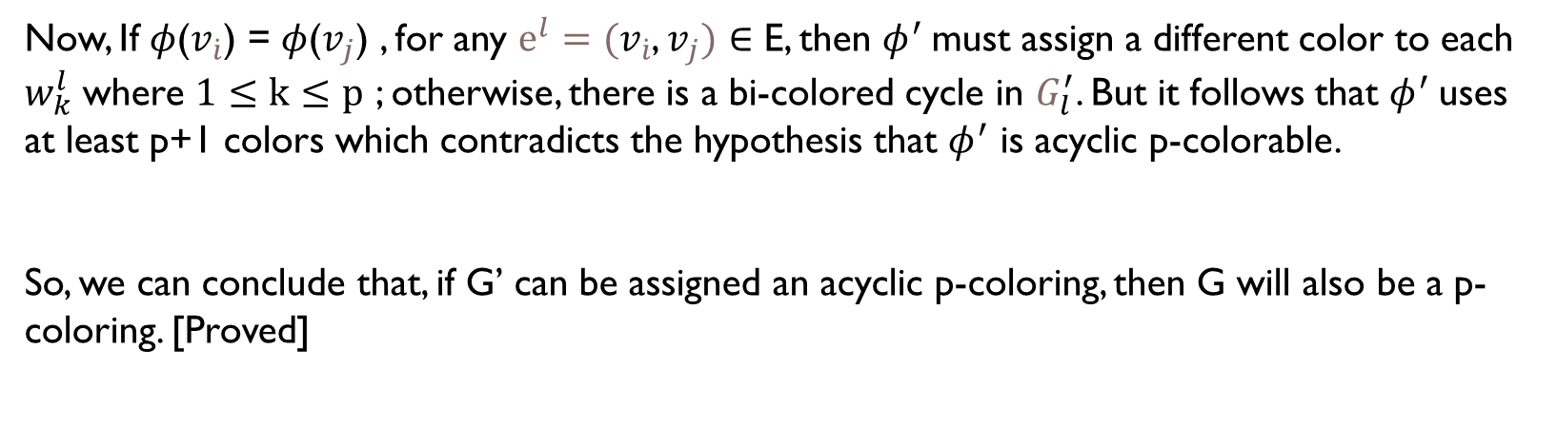
Now, If $φ$($v_{\dot{i}}$) = $φ$($v_{j}$) , for any $ⅇ^{l}=(v_{\dot{i}}$, $v_{j})$ $∈$ E, then $φ^{′}$must assign a different color to each $w_{k}^{l}$ where $1≤k≤p$ ; otherwise, there is a bi-colored cycle in $G_{l}^{′}$. But it follows that $φ^{′}$uses at least p+1 colors which contradicts the hypothesis that $φ^{′}$ is acyclic p-colorable. So, we can conclude that, if G’ can be assigned an acyclic p-coloring, then G will also be a p-coloring. [Proved]
So, p-coloring $≤_{p}$ Acyclic p-coloring

Slide 11
ID: 1905085
Name: MD Hasibul Hasan

Slide 12
Exact Algorithm
Backtracking:
Try to color the uncolored vertices from the color set.
If a conflict occurs (i.e., two adjacent vertices have the same color or violates acyclic condition) then backtrack

Slide 13
Approximation Algorithm
We know efficient heuristic approaches exist for k-coloring problem.
So, we will transform our input graph in such a way that if we k-color the transformed graph then our input graph will also be k-acyclic colored

Slide 14
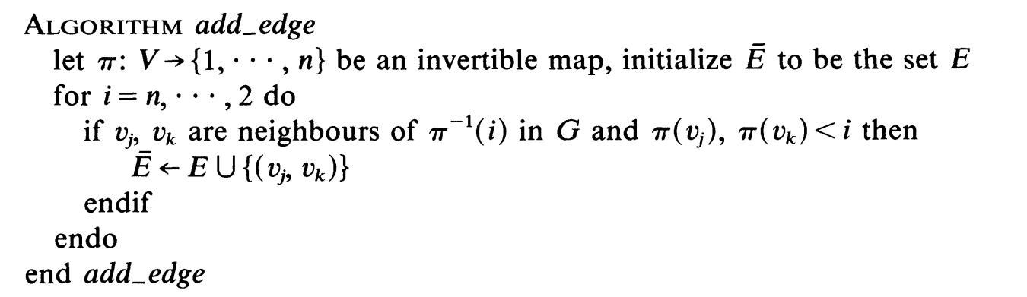
Graph Transformation
Now if we do vertex coloring on this Graph G’ then these coloring will be acyclic coloring on graph G.

Slide 15
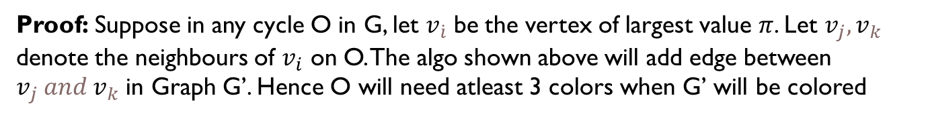
Graph Transformation
Proof: Suppose in any cycle O in G, let $v_{\dot{i}}$ be the vertex of largest value $π$. Let $v_{j},v_{k}$ denote the neighbours of $v_{i}$ on O. The algo shown above will add edge between $v_{j} and v_{k}$ in Graph G’. Hence O will need atleast 3 colors when G’ will be colored
It is clear that the initial ordering $π$ will affect the resulting graph G’ and consequently the number of colors used.

Slide 16
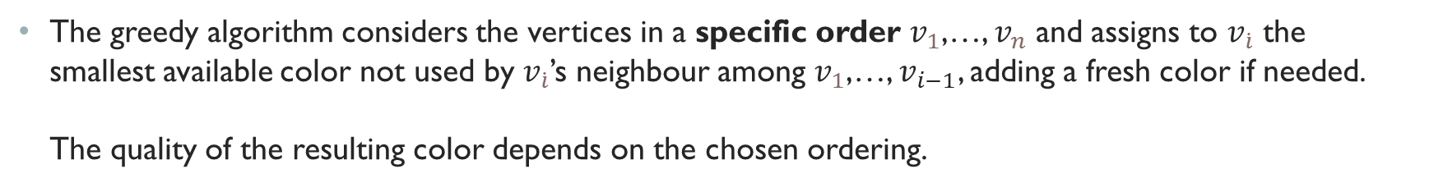
Greedy Coloring
The greedy algorithm considers the vertices in a specific order $v_{1}$,…, $v_{n}$ and assigns to $v_{\dot{i}}$ the smallest available color not used by $v_{\dot{i}}$’s neighbour among $v_{1}$,…, $v_{i−1}$, adding a fresh color if needed. The quality of the resulting color depends on the chosen ordering.
For example, Welsh–Powell algorithm sort the vertices in descending order based on their degrees

Slide 17
Heuristic Algorithm
Dsatur Algorithm
Degree of saturation: refers to how many different colors are already assigned to a vertex's neighbors.
Algorithm: Sort the vertices in decreasing order of degree of saturation and assign least possible (lowest numbered) color to the uncolored vertex.
Key Idea:
The idea is that vertices with many differently colored neighbors are harder to color because there are fewer color options left. The heuristic prioritizes these "difficult" vertices by coloring them earlier in the process.

Slide 18
Heuristic Algorithm
Recursive Largest First Algorithm:
Constructs each color class (a set of vertices that can all share the same color) one at a time. It does this by iteratively identifying maximal independent sets of vertices from the graph and assigning each set the same color. Then, it removes those vertices from the graph and repeats the process on the remaining subgraph.
The algorithm continues until all vertices have been assigned a color.

Slide 19
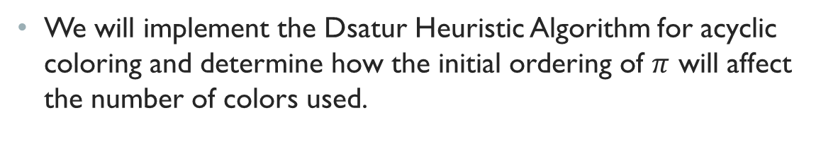
Experiment
We will implement the Dsatur Heuristic Algorithm for acyclic coloring and determine how the initial ordering of $π$ will affect the number of colors used.

Slide 20
An interesting result
Guillaume et al. Information Processing Letters,Volume 105, Issue 2
For any graph G of maximum degree 5, a linear-time algorithm exists that acyclically colors G in at most 9 colors.
Key idea:
It can be proved that any partially colored graph G of maximum degree 5 that uses at most 9 colors, and for any uncolored vertex u, there exists a way to color u in such a way that (i) G remains partially colored and (ii) at most 9 colors are used.

Slide 21
An interesting result
Algorithm:
From the graph G, arbitrarily pick an uncolored vertex u, and find a suitable color (among the 9 colors that are available) to color u
continue this process until all vertices are colored
It runs in linear time since for each of the n uncolored vertices considered, we need to look at distance at most 3 from it. So constant number of vertices consulted.

Slide 22

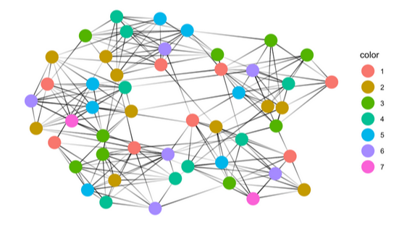
List coloring
ARNOB SAHA ANKON
1905108

Slide 23
List coloring problem
Given G = (V, E) be a graph where V be the set of vertices and E be the set of edges, C be a set of colors and for each vertex v ∈ V there is a list of colors L(v) ⊆ C.
Is there is a function f : V → C such that f (v) ∈ L(v) for all v ∈ V and f (u) ≠ f (v) for (u,v) ∈ E?
Is there a proper coloring of this graph?

Slide 24
Some Notation
A graph is k-choosable (or k-list-colorable) if it has a proper list coloring where |L(v)| = k for all v ∈ V
The choosability (or list colorability or list chromatic number) ch(G) of a graph G is the least number k such that G is k-choosable.

Slide 25
Properties
ch(G) ≥ χ(G) where χ(G) is chromatic number of G for graph coloring.
[2, 3]
[1, 2]
[1, 3]
[1, 3]
[1, 2]
[2, 3]

Slide 26
Reducing From NP-complete problem List coloring is in NP
If we have an assignment of colors f of a graph we can check in polynomial time-
f(v) ∈ L(v) for ∀v ∈ V
f(u) ≠ f(v) for (u, v) ∈ E
So, list coloring is in NP.

Slide 27
Reducing From NP-complete problem Graph coloring to List coloring
We will show :
$Graph Coloring ≤_{p}List Coloring$
Black box solver of List coloring
Input Instance of graph coloring
Input Instance of list coloring
Output of list coloring
Output of graph coloring

Slide 28
Reducing From NP-complete problem Construction
Suppose we are given a graph G and we want to determine if it is k-colorable. To do this, we will construct a new graph G′ with the following properties:
The vertices of the new graph G′ are the same as the vertices of the original graph G:
V(G′)=V(G).
The edges of the new graph G′ are the same as the edges of the original graph G:
E(G′)=E(G).
We we create a list L of k distinct colors as {1,2,3 …, k}
For each vertex v∈V(G′), we will assign list L
Thus, the list for each vertex v∈V(G′) contains same k colors. The resulting instance (G', L) is a list coloring problem, where G′ is the graph and L is the list assignment.

Slide 29
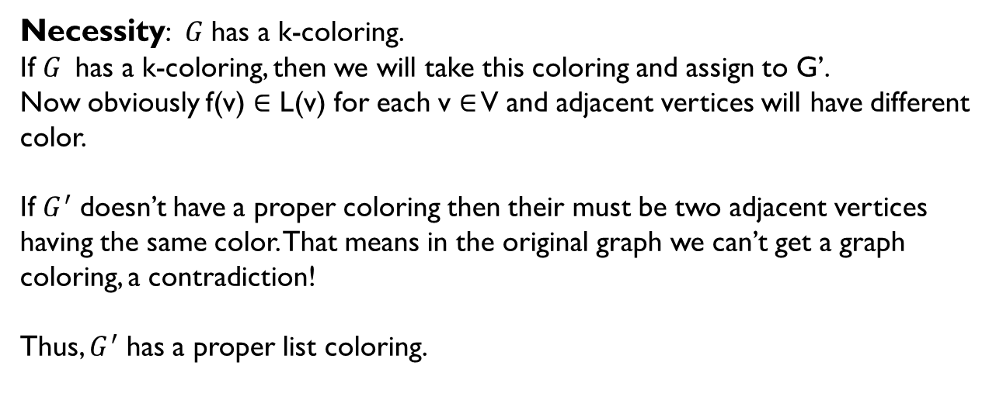
Reducing From NP-complete problem Claim
$G^{ }$ has a k-coloring if and only if $G^{′}$ has a proper coloring.
Necessity: $G^{ }$has a k-coloring.
If $G^{ }$has a k-coloring, then we will take this coloring and assign to G’.
Now obviously f(v) ∈ L(v) for each v ∈ V and adjacent vertices will have different color.
If $G^{′}$ doesn’t have a proper coloring then their must be two adjacent vertices having the same color. That means in the original graph we can’t get a graph coloring, a contradiction!
Thus, $G^{′}$ has a proper list coloring.

Slide 30
Reducing From NP-complete problem Claim
$G^{ }$ has a k-coloring if and only if $G^{′}$ has a proper coloring.
Necessity: $G^{ }$has a k-coloring.
If $G^{ }$has a k-coloring, then we will take this coloring and assign to G’.
Now obviously f(v) ∈ L(v) for each v ∈ V and adjacent vertices will have different color.
If $G^{′}$ doesn’t have a proper coloring then their must be two adjacent vertices having the same color. That means in the original graph we can’t get a graph coloring, a contradiction!
Thus, $G^{′}$ has a proper list coloring.

Slide 31
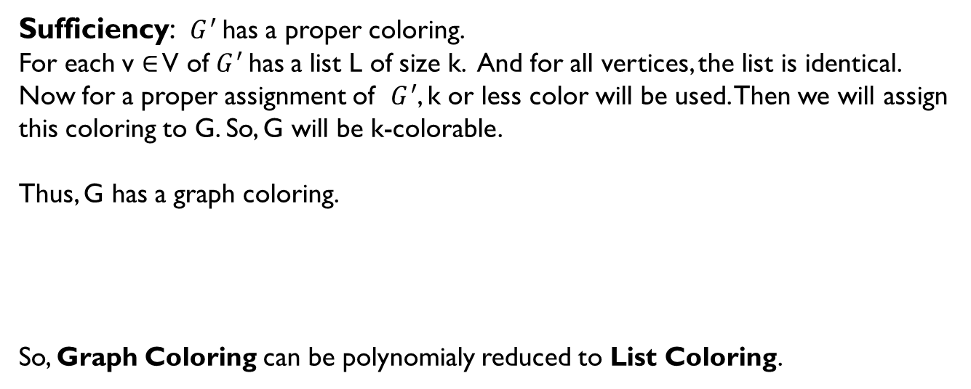
Reducing From NP-complete problem Claim
$G^{ }$ has a k-coloring if and only if $G^{′}$ has a proper coloring.
Sufficiency: ${G^{′}}^{ }$has a proper coloring.
For each v ∈ V of$G^{′}$has a list L of size k. And for all vertices, the list is identical. Now for a proper assignment of $G^{′}$, k or less color will be used. Then we will assign this coloring to G. So, G will be k-colorable.
Thus, G has a graph coloring.
So, Graph Coloring can be polynomialy reduced to List Coloring.

Slide 32
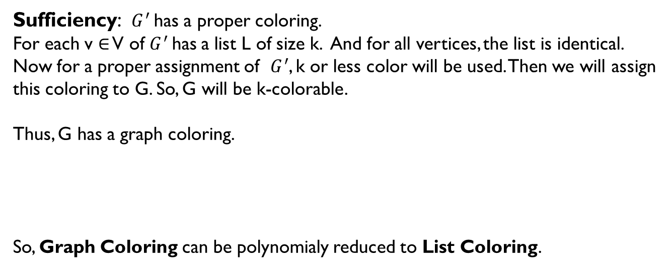
Reducing From NP-complete problem Claim
$G^{ }$ has a k-coloring if and only if $G^{′}$ has a proper coloring.
Sufficiency: ${G^{′}}^{ }$has a proper coloring.
For each v ∈ V of$G^{′}$has a list L of size k. And for all vertices, the list is identical. Now for a proper assignment of $G^{′}$, k or less color will be used. Then we will assign this coloring to G. So, G will be k-colorable.
Thus, G has a graph coloring.
So, Graph Coloring can be polynomialy reduced to List Coloring.

Slide 33
Greedy Algorithm
Key idea-
Order the vertices (e.g., using a heuristic )
For each vertex, select the smallest color from its list that does not conflict with the colors assigned to adjacent vertices.
Proceed until all vertices are colored.
d
c
a
b
Common Heuristics:
Largest Degree First
Smallest List First
Saturation Degree Heuristic (DSatur)
Saturation degree is the number of different colors in its neighborhood.
c, a, b, d

Slide 34
Greedy Algorithm
Key idea-
Order the vertices (e.g., using a heuristic )
For each vertex, select the smallest color from its list that does not conflict with the colors assigned to adjacent vertices.
Proceed until all vertices are colored.
d
c
a
b
Common Heuristics:
Largest Degree First
Smallest List First
Saturation Degree Heuristic (DSatur)
Saturation degree is the number of different colors in its neighborhood.
c, a, b, d

Slide 35
Greedy Algorithm
Key idea-
Order the vertices (e.g., using a heuristic )
For each vertex, select the smallest color from its list that does not conflict with the colors assigned to adjacent vertices.
Proceed until all vertices are colored.
d
c
a
b
Common Heuristics:
Largest Degree First
Smallest List First
Saturation Degree Heuristic (DSatur)
Saturation degree is the number of different colors in its neighborhood.
c, a, b, d

Slide 36
Greedy Algorithm
Key idea-
Order the vertices (e.g., using a heuristic )
For each vertex, select the smallest color from its list that does not conflict with the colors assigned to adjacent vertices.
Proceed until all vertices are colored.
d
c
a
b
Common Heuristics:
Largest Degree First
Smallest List First
Saturation Degree Heuristic (DSatur)
Saturation degree is the number of different colors in its neighborhood.
c, a, b, d

Slide 37
Greedy Algorithm
Key idea-
Order the vertices (e.g., using a heuristic )
For each vertex, select the smallest color from its list that does not conflict with the colors assigned to adjacent vertices.
Proceed until all vertices are colored.
d
c
a
b
Common Heuristics:
Largest Degree First
Smallest List First
Saturation Degree Heuristic (DSatur)
Saturation degree is the number of different colors in its neighborhood.
c, a, b, d

Slide 38
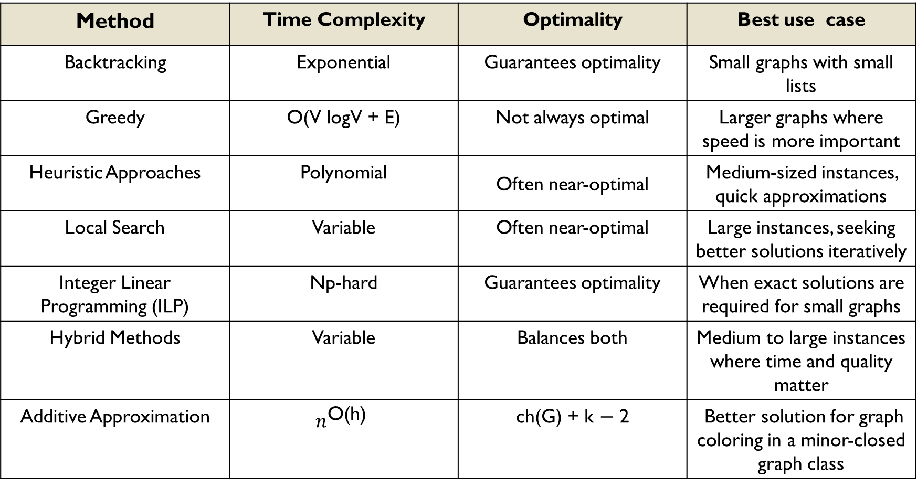
Other Algorithms of list coloring
Method | Time Complexity | Optimality | Best use case
Backtracking | Exponential | Guarantees optimality | Small graphs with small lists
Greedy | O(V logV + E) | Not always optimal | Larger graphs where speed is more important
Heuristic Approaches | Polynomial | Often near-optimal | Medium-sized instances, quick approximations
Local Search | Variable | Often near-optimal | Large instances, seeking better solutions iteratively
Integer Linear Programming (ILP) | Np-hard | Guarantees optimality | When exact solutions are required for small graphs
Hybrid Methods | Variable | Balances both | Medium to large instances where time and quality matter
Additive Approximation | $$n^{\text{O}\text{(}\text{h}\text{)}}$$ | ch(G) + k − 2 | Better solution for graph coloring in a minor-closed graph class

Slide 39


Practical usages of list coloring
Wireless Networks
Frequency assignment
Due to hardware restrictions, each radio has a limited set of available frequencies, and nearby radios cannot share the same frequency due to interference. This can be modeled as a graph where vertices represent radios, and each vertex has a list of allowable frequencies. The goal is to find a list coloring that assigns a frequency to each radio without interference.
Constraint Satisfaction
Resource allocation
Ensuring resources are assigned while respecting availability constraints.

Slide 40
Experiment
Greedy Algorithm with different heuristics
We wish to implement the Greedy Algorithm with different heuristics for List coloring and wish to measure the performance for different types of graph class. For example: path graph, complete graph , circuit graph etc.

Slide 41
ID: 1905016
Name: MD Zulkar Naim

Slide 42
Distance-k coloring
Vertices that are at most k edges apart in the graph must have different colors
Generalization of normal graph coloring (distance-1 coloring)

Slide 43
B
D
A
C

Slide 44
B
D
A
C

Slide 45
B
D
A
C

Slide 46
B
D
A
C

Slide 47
B
D
A
C

Slide 48
B
D
A
C
Normal Graph Coloring (distance-1)

Slide 49
B
D
B
D
A
C
A
C
Normal Graph Coloring (distance-1)

Slide 50
B
D
B
D
A
C
A
C
Normal Graph Coloring (distance-1)
Distance-2 Coloring

Slide 51
B
D
B
D
A
C
A
C
Normal Graph Coloring (distance-1)
Distance-2 Coloring

Slide 52
B
D
B
D
A
C
A
C
Normal Graph Coloring (distance-1)
Distance-2 Coloring

Slide 53
B
D
B
D
A
C
A
C
Normal Graph Coloring (distance-1)
Distance-2 Coloring

Slide 54
B
D
B
D
A
C
A
C
Normal Graph Coloring (distance-1)
Distance-2 Coloring

Slide 55
Reduction: Distance-k coloring to normal graph coloring (distance-1 coloring)

Slide 56
Reduction: Distance-k coloring to normal graph coloring (distance-1 coloring)
Given a graph G=(V,E)
B
D
A
C

Slide 57
Reduction: Distance-k coloring to normal graph coloring (distance-1 coloring)
Given a graph G=(V,E)
We have to construct power-k graph G^{k}
B
D
A
C

Slide 58
Reduction: Distance-k coloring to normal graph coloring (distance-1 coloring)
Given a graph G=(V,E)
We have to construct power-k graph G^{k}
B
D
What is power-k graph?
A
C

Slide 59
G=(V,E)
B
D
A
C

Slide 60
G=(V,E)
G²
B
D
A
C

Slide 61
G=(V,E)
G²
B
D
B
D
A
C
A
C

Slide 62
G=(V,E)
G²
B
D
B
D
A
C
A
C

Slide 63
G=(V,E)
G²
B
D
B
D
A
C
A
C

Slide 64
G=(V,E)
G²
B
D
B
D
A
C
A
C

Slide 65
G=(V,E)
G²
B
D
B
D
A
C
A
C

Slide 66
G²
B
D
A
C

Slide 67
G²
B
D
A
C
Normal graph coloring (distance-1 coloring)

Slide 68
G²
B
D
A
C
Normal graph coloring (distance-1 coloring)

Slide 69
G²
B
D
A
C
Normal graph coloring (distance-1 coloring)

Slide 70
G²
B
D
A
C
Normal graph coloring (distance-1 coloring)

Slide 71
G²
B
D
A
C
Normal graph coloring (distance-1 coloring)

Slide 72
Distance – k coloring algorithms:
Backtracking
Greedy
DSATUR (Degree of Saturation)
Branch and bound

Slide 73
Distance – k coloring algorithms:
Backtracking
Greedy
DSATUR (Degree of Saturation)
Branch and bound

Slide 74
DSATUR (Degree of saturation)

Slide 75
DSATUR (Degree of saturation)
Choose the vertex with highest saturation degree

Slide 76
DSATUR (Degree of saturation)
B
D
Choose the vertex with highest saturation degree
A
C
Distance-2 coloring

Slide 77
DSATUR (Degree of saturation)
[ ]
[ ]
B
D
Choose the vertex with highest saturation degree
A
C
[ ]
[ ]
Distance-2 coloring

Slide 78
DSATUR (Degree of saturation)
[ ]
[ ]
B
D
Choose the vertex with highest saturation degree
In case of tie, choose the one with highest degree
A
C
[ ]
[ ]
Distance-2 coloring

Slide 79
DSATUR (Degree of saturation)
[ ]
[ ]
B
D
Choose the vertex with highest saturation degree
In case of tie, choose the one with highest degree
A
C
[ ]
[ ]
Distance-2 coloring

Slide 80
DSATUR (Degree of saturation)
[ ]
[ ]
B
D
Choose the vertex with highest saturation degree
In case of tie, choose the one with highest degree
A
C
[ ]
[ ]
[A, B, D ]
Distance-2 coloring

Slide 81
DSATUR (Degree of saturation)
[ ]
[ ]
[A, C, D ]
[B, C ]
B
D
Choose the vertex with highest saturation degree
In case of tie, choose the one with highest degree
A
C
[ ]
[ ]
[B, C ]
[A, B, D ]
Distance-2 coloring

Slide 82
DSATUR (Degree of saturation)
[ ]
[ ]
[A, C, D ]
[B, C ]
B
D
2. Assign the lowest available color (not used by its neighbors) to that vertex
A
C
[ ]
[ ]
[B, C ]
[A, B, D ]
Distance-2 coloring

Slide 83
DSATUR (Degree of saturation)
[ ]
[ ]
[A, C, D ]
[B, C ]
B
D
2. Assign the lowest available color (not used by its neighbors) to that vertex
A
C
[ ]
[ ]
[B, C ]
[A, B, D ]
Distance-2 coloring

Slide 84
DSATUR (Degree of saturation)
[ ]
[ ]
[A, C, D ]
[B, C ]
B
D
3. Update the saturation degrees of its neighbors
A
C
[ ]
[ ]
[B, C ]
[A, B, D ]
Distance-2 coloring

Slide 85
[ ]
[■]
[A, C, D ]
[B, C ]
B
D
3. Update the saturation degrees of its neighbors
A
C
[■]
[■]
[B, C ]
[A, B, D ]
Distance-2 coloring

Slide 86
DSATUR (Degree of saturation)
[ ]
[■]
[A, C, D ]
[B, C ]
Choose the vertex with highest saturation degree
In case of tie, choose the one with highest degree
2. Assign the lowest available color (not used by its neighbors) to that vertex
3. Update the saturation degrees of its neighbors
B
D
A
C
[■]
[■]
[B, C ]
[A, B, D ]
Distance-2 coloring

Slide 87
DSATUR (Degree of saturation)
[ ]
[■]
[A, C, D ]
[B, C ]
Choose the vertex with highest saturation degree
In case of tie, choose the one with highest degree
2. Assign the lowest available color (not used by its neighbors) to that vertex
3. Update the saturation degrees of its neighbors
B
D
A
C
[■]
[■]
[B, C ]
[A, B, D ]
Distance-2 coloring

Slide 88
DSATUR (Degree of saturation)
[ ]
[■ ■]
[A, C, D ]
[B, C ]
Choose the vertex with highest saturation degree
In case of tie, choose the one with highest degree
2. Assign the lowest available color (not used by its neighbors) to that vertex
3. Update the saturation degrees of its neighbors
B
D
A
C
[■ ■]
[■]
[B, C ]
[A, B, D ]
Distance-2 coloring

Slide 89
DSATUR (Degree of saturation)
[ ]
[■ ■]
[A, C, D ]
[B, C ]
Choose the vertex with highest saturation degree
In case of tie, choose the one with highest degree
2. Assign the lowest available color (not used by its neighbors) to that vertex
3. Update the saturation degrees of its neighbors
B
D
A
C
[■ ■]
[■]
[B, C ]
[A, B, D ]
Distance-2 coloring

Slide 90
DSATUR (Degree of saturation)
[ ]
[■ ■]
[A, C, D ]
[B, C ]
Choose the vertex with highest saturation degree
In case of tie, choose the one with highest degree
2. Assign the lowest available color (not used by its neighbors) to that vertex
3. Update the saturation degrees of its neighbors
B
D
A
C
[■ ■]
[■]
[B, C ]
[A, B, D ]
Distance-2 coloring

Slide 91
Real world applications:
Telecommunications & Networking: Frequency assignment in wireless network
Circuit Design: Avoiding interference in VLSI design
Scheduling: Task, exam, or traffic light scheduling
Resource Allocation: Memory bank allocation, processor scheduling

Slide 92
Md. Rifat Rahman 1905094

Slide 93
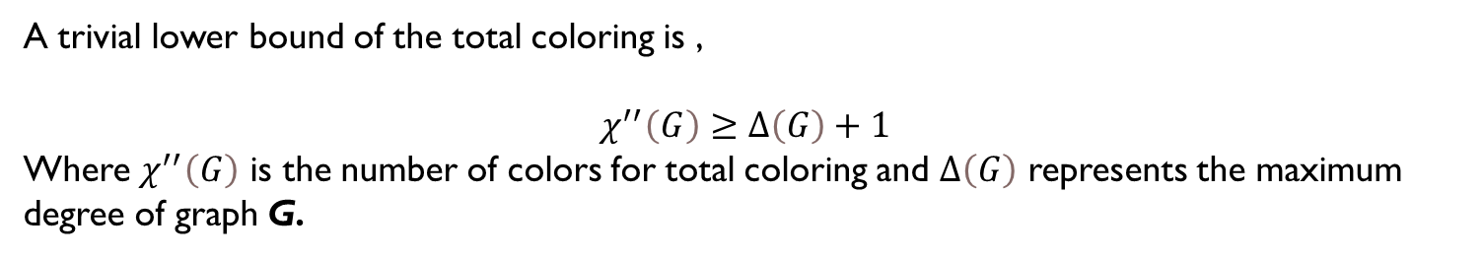
Total Coloring
Total coloring is a variant of graph coloring where both edges and vertices have to be colored. The constraints are as follows:
1. No two vertices connected by an edge can have the same color.
2. All the edges sharing a same endpoint must be colored differently.
3. The two vertices and their connecting edge must be colored differently
A trivial lower bound of the total coloring is ,
$$χ^{′′}\left(G\right)≥Δ\left(G\right)+1$$
Where $χ^{′′}\left(G\right)$ is the number of colors for total coloring and $Δ\left(G\right)$ represents the maximum degree of graph G.

Slide 94
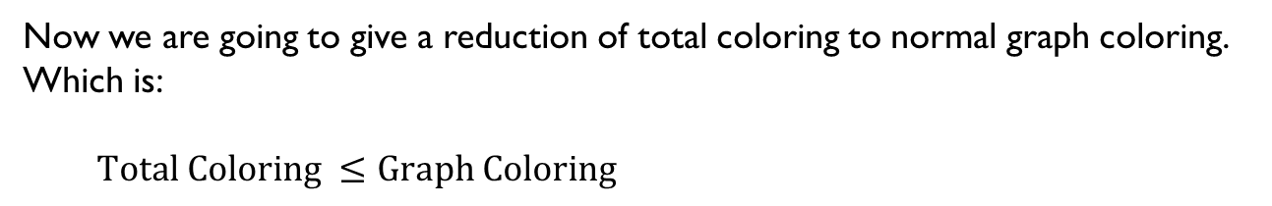
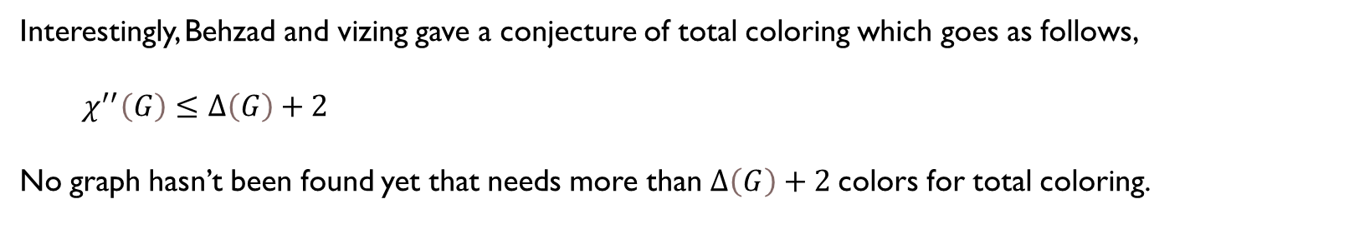
Interestingly, Behzad and vizing gave a conjecture of total coloring which goes as follows,
$χ^{′′}\left(G\right)≤Δ\left(G\right)+2$
No graph hasn’t been found yet that needs more than $Δ\left(G\right)+2$colors for total coloring.
Reduction
Now we are going to give a reduction of total coloring to normal graph coloring. Which is:
$Total Coloring ≤Graph Coloring$

Slide 95
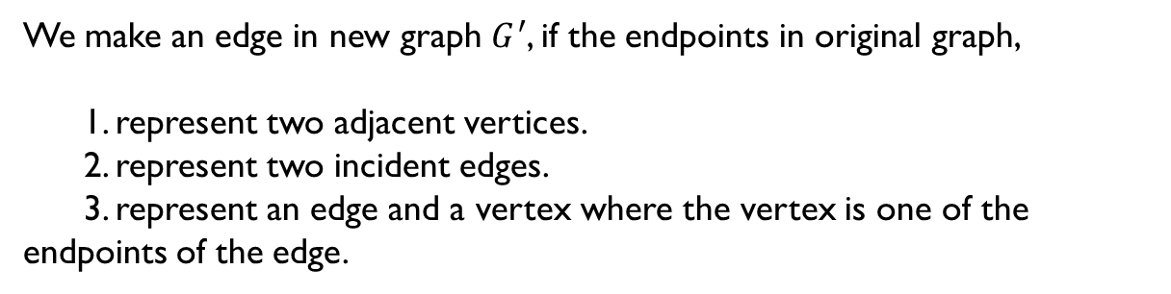
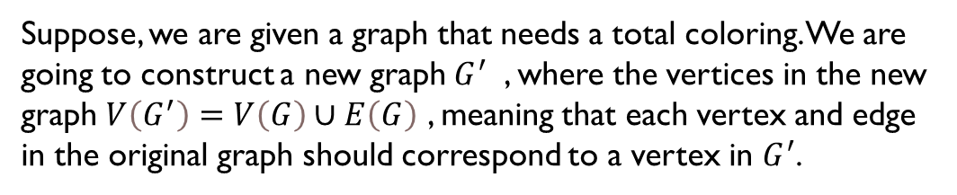
Construction
Suppose, we are given a graph that needs a total coloring. We are going to construct a new graph$G^{′}$ , where the vertices in the new graph $V\left(G^{′}\right)=V\left(G\right)∪E\left(G\right)$ , meaning that each vertex and edge in the original graph should correspond to a vertex in $G^{′}$.
We make an edge in new graph $G^{′}$, if the endpoints in original graph,
1. represent two adjacent vertices.
2. represent two incident edges.
3. represent an edge and a vertex where the vertex is one of the endpoints of the edge.

Slide 96

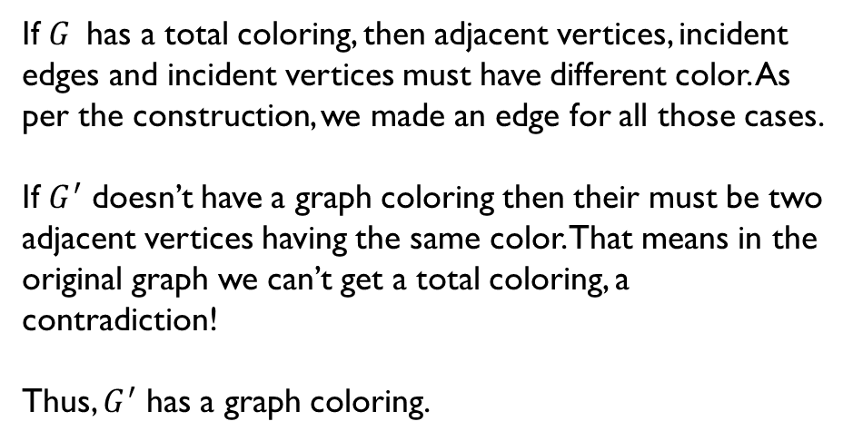
Claim
$G^{ }$ has a total coloring if and only if $G^{′}$ has a graph coloring.
Necessity:
$G^{ }$has a total coloring.
If $G^{ }$has a total coloring, then adjacent vertices, incident edges and incident vertices must have different color. As per the construction, we made an edge for all those cases.
If $G^{′}$ doesn’t have a graph coloring then their must be two adjacent vertices having the same color. That means in the original graph we can’t get a total coloring, a contradiction!
Thus, $G^{′}$ has a graph coloring.

Slide 97
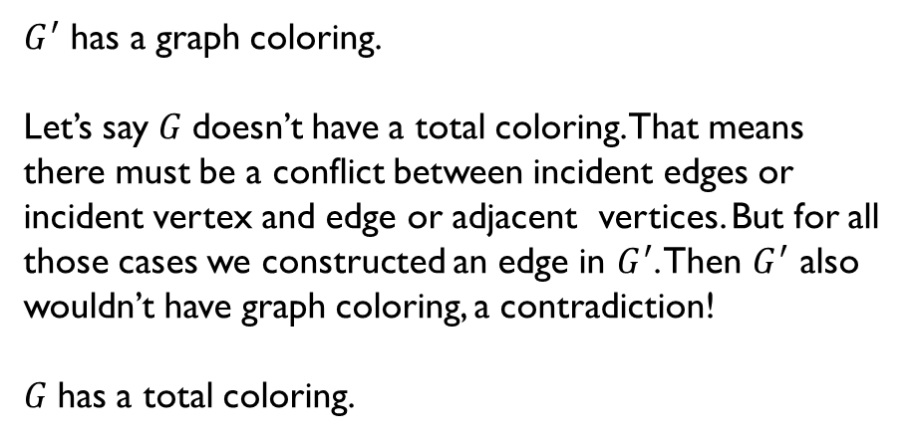
Sufficiency:
$G^{′}$ has a graph coloring.
Let’s say $G^{ }$doesn’t have a total coloring. That means there must be a conflict between incident edges or incident vertex and edge or adjacent vertices. But for all those cases we constructed an edge in $G^{′}$. Then $G^{′}$ also wouldn’t have graph coloring, a contradiction!
$G^{ }$has a total coloring.

Slide 98
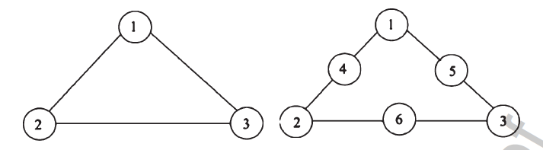
Heuristic Algorithm:
A genetic algorithm has been proposed to find the Total Chromatic Number (Number of colors needed for total coloring)
1. Encoding : At first , we need to modify our graph for the purpose of our algorithm. A new vertex is added between each of adjacent vertices.

Slide 99
2. Fitness Function:
Fitness function gives a value that indicates the number of colors needed for total coloring . It is a greedy algorithm that is run to find a TCN (Total chromatic number).
Step 1:
Initially, we have k = 0 and color_number = 0. k value represents how many nodes we have colored until now . color_number represents how many colors have been used.
Step 2:
Check whether k+1 th vertex has been colored or not. If not, then find the minimum value j between 1 to n (n is the number of vertices in new graph) such that j is not present in the adjacent vertices or the adjacent of adjacent vertices. Then color the k+1 th vertex with color j.
If j > color_number then assign j to color_number.
Step 3: Increment k by 1.
Step 4: If k is not equal to n then run step 2 and 3 again. Else return color_number as the fitness value.

Slide 100
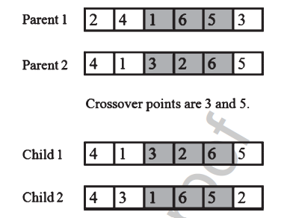
3. Selection:
We give higher probability to the color assignment with lowest value. And lesser probability to higher TCN.
4.Crossover:
We pick two parent probabilistically. Then crossover is done between those to get a new assignment. Here we use LOX crossover. This goes as follows:
Step 1: Two random points are chosen between 1 to n , point1 and point 2 such that point1 < point2.
Step 2: The vertices from point1 to point2 from Parent2 is copied directly to Child1.
Step 3: The remaining vertices from Parent2 is rearranged in the available positions of Child1 following their order in Parent1.
Step 4: The similar is done with Parent1 and Child2.

Slide 101
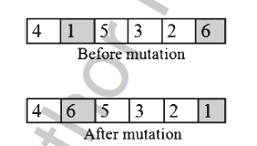
5. Mutation:
Mutation is applied to the population with a certain probability to avoid local convergence.
Step 1: Choose two random points P1 , P2 from a randomly selected coloring.
Step 2: Exchange the vertices of position P1 and P2.

Slide 102
Experiment :
We wish to implement the Genetic Algorithms for total coloring. Our target is to measure the performance for different types of graph class. For example: path graph, complete graph , circuit graph etc.

Slide 103
Real life example
Scheduling
Partitioning
Networking

Slide 104
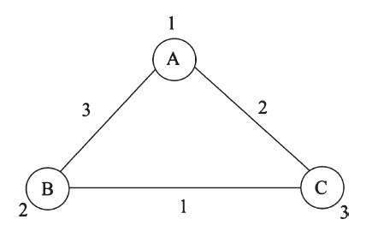
A Scheduling Example:
Suppose there is a cricket ground and a practice ground. A tournament is being held . Each of the team gets a day for practicing. Also, let’s say there are 3 teams. We want to know minimum how many days are required to finish the tournament.
In the following graph, we could treat the vertex color as the day of that team’s practice. The edge representing the matchday of those two teams.
Incident edges can’t have same color because a team can’t play two match in a day. Adjacent vertex can’t have same color because two teams can’t practice on the same day.
Incident edge and vertex can’t have same color as a team can’t have it’s practice and matchday in a single day.
Thus this is total coloring . The number of colors represents number of days needed to finish the tournament.

Slide 105
Thank You

